Slide 1
Creating Workflows with SharePoint Designer 2010
Notes:
One of the extremely powerful features in SharePoint Designer 2010 is the ability to create dynamic and reusable Workflows. SharePoint Designer's workflows let you design powerful multi-step workflows from scratch or to build upon the out-of-the-box reusable workflows. You can even create your workflow in Visio 2010 and then import it within SharePoint Designer 2010. In addition to all that, you can customize your workflow input forms using InfoPath 2010. In this module, you will learn all about SharePoint Designer Workflow's and their integration with Visio and InfoPath.

Slide 2
Agenda
What is Workflow?
Types of SharePoint Designer Workflows
Tools to Create Workflows in SharePoint
Visio Integration with Workflows
InfoPath Integration with Workflows
Task Process Designer
Packaging of Reusable Workflows

Slide 3
What is Workflow?
Automation of business logic
Rules for data that resides on SharePoint
Applied automatically or on demand
“Glue” used to build common business apps
Managing how people work
Document approval & feedback
Collaborative reviews & discussions
Gathering signatures
Notes:
Workflow provides an orderly process:
Manages interaction between workers.
Automates previously manual processes.
Provides process participants with tasks lists.
Workflow allows each of these smaller pieces to be tied together into a larger process. It manages the processes that we used to manage via email and shared files. Without something to manage it, information is lost, people miss email and there is no data stored about the process allowing future improvement via metrics analysis.

Slide 4
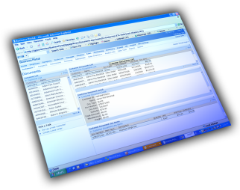




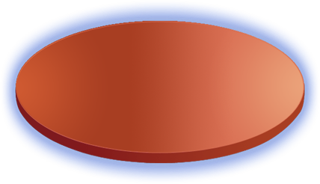




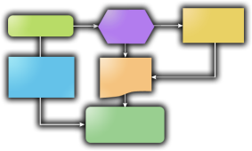










Types of Workflow
Human Workflow
System Workflow
Business to Business
Supply Chain Mgmt…
Information Worker
Document Review
Signature Collection
Records Retention
Expense Reporting
Application Processing
Many others…..
Participants are people
Flexible control flow, ad-hoc
Participants are services, apps
Prescriptive control flow, transactional
Line of Business Apps
Sales Automation…
CRM
ERP
Notes:
Workflow processes can be completely automated or very much human driven or a combination of both. Each scenario calls for an appropriate type of a solution that’s a blend of systematic and human drive workflow.

Slide 5
SharePoint Development Platform
SharePoint Server Capabilities
Content
Search
Compositions
Insights
Sites
Communities
Pages and User Interface
Web UI
Framework
Web Parts
ASP.NET forms
Silverlight
XSLT Views
Server APIs
Connected Client APIs
Event Model
LINQ
Web Services
REST
Client OM
Application Model (Sites)
Application Lifecycle
Data Model Lists
Content Management
Solutions
File System
Content Types
Lists
Library Features
Templates
External Lists
Workflow
Features
New
Improved
Query
Notes:
Workflow as part of the SharePoint development ‘Big Picture’.
Workflows in SharePoint are provided via the Windows Workflow Foundation (WF) which is included in the .NET Framework. SharePoint 2010’s workflow is based on WF in .NET 3.5 SP1.

Slide 6




Why do we Need Workflow?
Office applications provide rich client UI
Simplified document creation
Access to portal data via Word, Excel, etc…
Does not provide process relating documents
?
Notes:
Business processes require that people and/or systems work together to accomplish milestones. Approving a document, ordering a widget, creating invoices etc are all types of processes which require a variety of actions. The implementation of business processes can be accomplished through workflows.
Office Business Applications (OBA) provide great client integration to SharePoint, however without process to tie things together, they can’t solve business problems.

Slide 7
Agenda
What is Workflow?
Types of SharePoint Designer Workflows
Tools to Create Workflows in SharePoint
Visio Integration with Workflows
InfoPath Integration with Workflows
Task Process Designer
Packaging of Reusable Workflows

Slide 8


SharePoint Workflow Authoring Tools
Out-of-Box Workflows
SharePoint Designer 2010
Rules based Declarative Workflows
Visual Studio 2010
Notes:
There are three ways to build workflows in SharePoint:
OOTB Workflow Templates: The OOTB workflow templates can be used by Site Administrators to create workflows using the browser. These workflows fulfill the need for the basic type of Approval processes.
SharePoint Designer Workflows: SharePoint Designer uses a declarative rules based engine to create powerful workflows. These workflows are created in the XAML language (XML based) and work as sequential workflows.
Visual Studio Workflows: Visual Studio provides a robust development environment that requires more specialization to use, but also provides more power.

Slide 9
2010 Office Workflow
Continued investment in declarative platform
Least amount of friction to deploy
Need flexibility previously available only in code
Templates = write once, use anywhere
More activities and more ways to manipulate data
Common approval semantics out of the box
Enhance SPD tooling surface
New designer leveraging Office Fluent UI
Tools integration with Visio, Visual Studio (more on this later)
Notes:
The Past: 2007 Workflows
Out-of-box routing and review workflows:
Best of breed, capture 80% approval scenarios.
Customizable through web-based UI.
Office client integration (tasks are in context).
Build your own with SharePoint Designer 2010:
Quick to prototype, “fire and forget”.
Rules designer lets you read out the logic.
No code = designers + remote deployment.
Full development using Visual Studio

Slide 10
SharePoint Workflow Targets
List Items
Documents
2010
List Items
Documents
Sites
Document Sets
2007
Notes:
SharePoint 2010 adds more items to attach workflows to. The items supported in SharePoint 2007 are still around, but now there’s more.
The Sites workflow allows site level operations to occur without the need for an item. Document sets are an extension of the folder content type that allows a set of documents to be the focus of a workflow.

Slide 11



SharePoint Designer Workflows
Attached directly to a List
Can be associated to many Lists or Content Types
Site based – not associated to a List or Content Type
Notes:
SharePoint Designer Workflows are attached to a container:
List Workflows are attached to a specific list.
Reusable Workflows are attached to lists,libraries or content types.
May be constrained to a content type.
Site Workflows are attached to the current site.
The reusable and site workflows functionality is new in SPD 2010.
Previously in SPD 2007, we were limited to associating workflows with lists or document libraries.

Slide 12
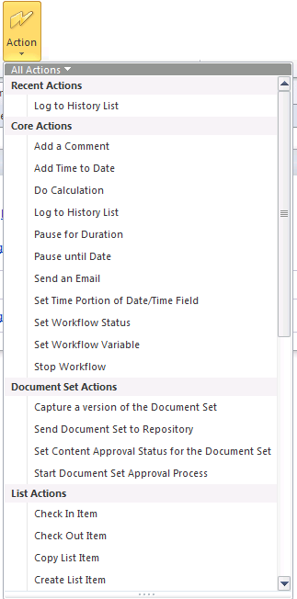
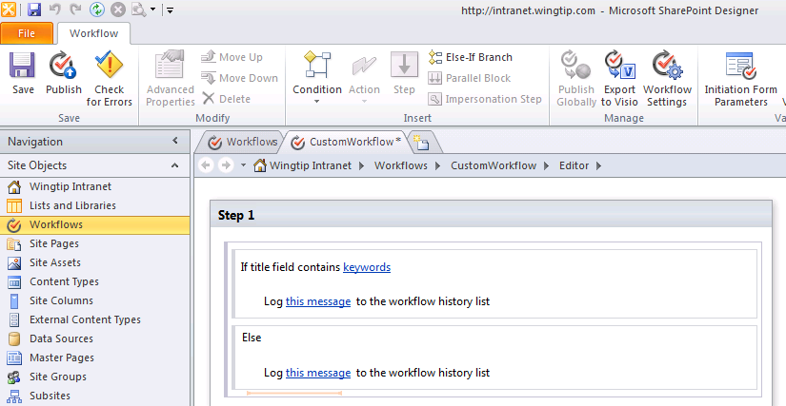
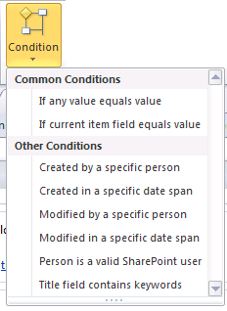
Workflows Designer interface
Declarative workflow designer
Notes:
Workflow designer is completely integrated within the SharePoint Designer environment. By making use of the ribbon a more natural feel to the authoring of workflows is provided. This designer is capable of creating sequential workflows.
Note: The new designer does not break any existing workflow investments you have made in SharePoint 2007.
Workflows are composed of pre-existing building blocks and conditional logic
Based on Events, Conditions, and Actions
Described by XOML files
Triggered by initiation form or list events
Supports rich data binding to list items
Workflows processes are broken up into logical sections. Custom activities can be written using Visual Studio to combine complex processes into a simple Action or Condition.

Slide 13
DEMO
Exploring the Workflow Designer Interface

Slide 14
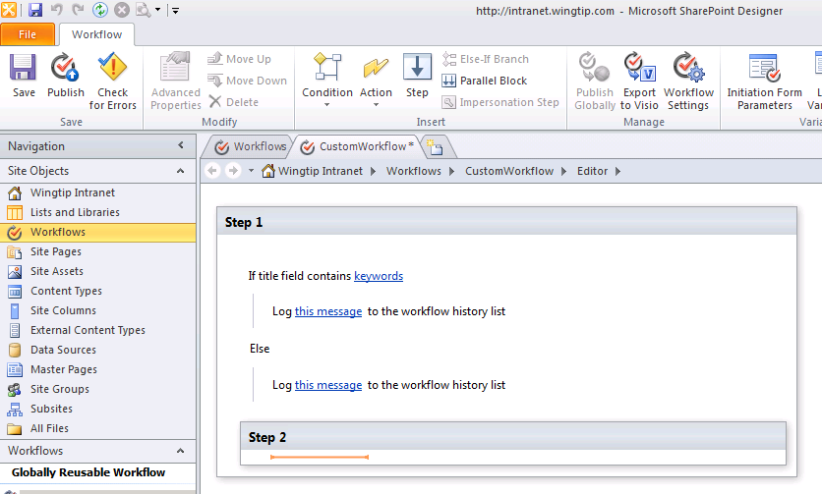
Nested Logic in SharePoint Designer
Notes:
SharePoint Designer 2007 had some limitations to nesting logical operations combined with parallel and sequential blocks of actions. These limitations have now been removed.

Slide 15
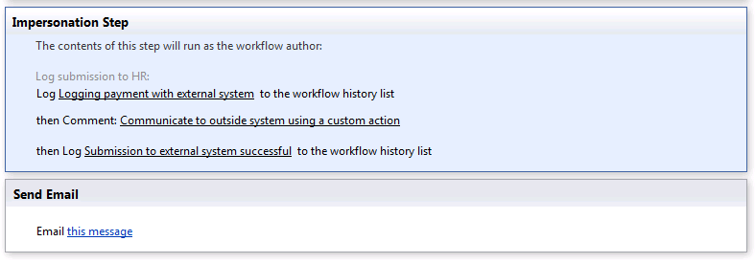
Performing Secure Operations
By default, SPD workflows run as initiator
In SP 2007 this was the only option
In SP 2010 impersonation is possible in SPD
Use an Impersonation Step
Notes:
What if we need the workflow to perform an action the initiator can’t perform? In SP2007 we were out of luck in SPD and had to use Visual Studio, now we can use an impersonation step.
Keep in mind that the Impersonation step does not impersonate System Account, it impersonates the user that created the workflow. This is important since Administrators don’t need to approve SPD workflows so the process can never have more permissions than the user creating it.

Slide 16
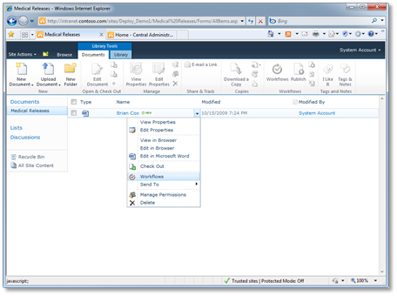
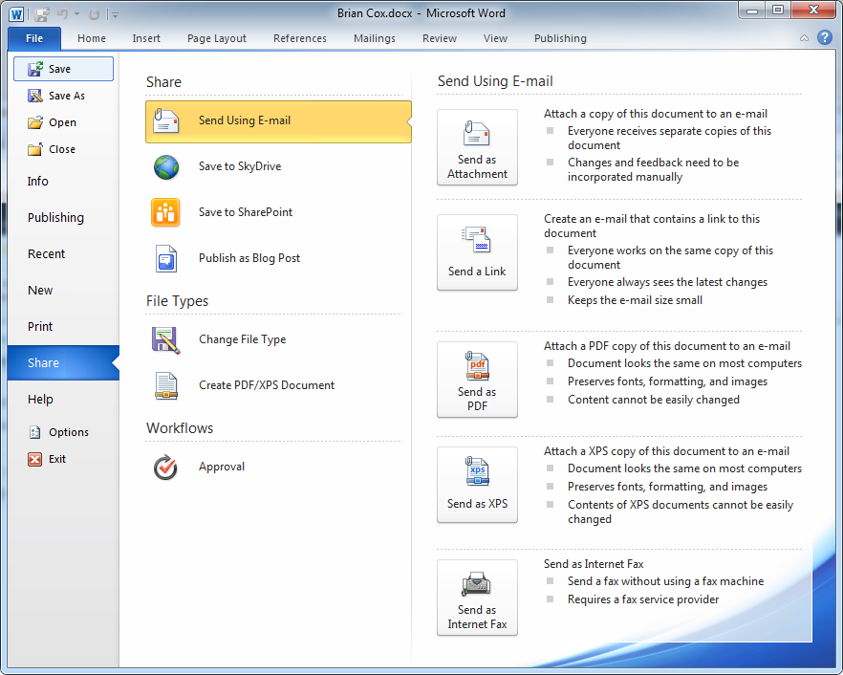
Initiating Workflows
Workflow instances are initiated on items
Sites, items, documents, document sets
Initiated in browser or through the office client

Slide 17
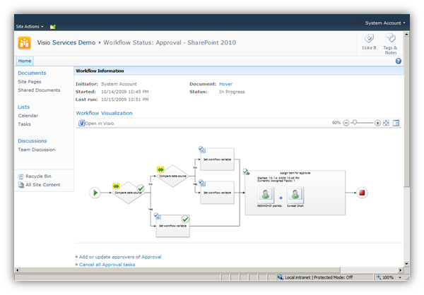
Workflow Visualization
Using Visio Services extensibility features you can visualize workflow status with Visio Services in SharePoint (also supports Silverlight)
Notes:
If Visio Services is running on the server, visual status of running workflows can be made available on the status page of any workflow.

Slide 18
DEMO
Advanced Workflow Techniques

Slide 19
Agenda
What is Workflow?
Types of SharePoint Designer Workflows
Tools to Create Workflows in SharePoint
Visio Integration with Workflows
InfoPath Integration with Workflows
Task Process Designer
Packaging of Reusable Workflows

Slide 20
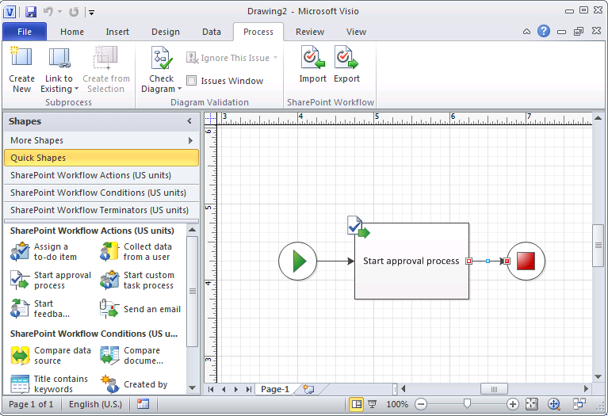
IW’s / BA’s Model Workflows in Visio 2010
Special SharePoint Workflow Template
Contains stencils for conditions and actions
Notes:
The visual aspect of Visio is the key. It gives stakeholders the ability to visually see the process instead of a linear set of steps. It hides the details and focuses on the process flow.

Slide 21
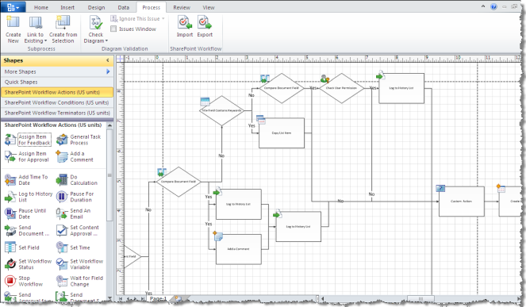
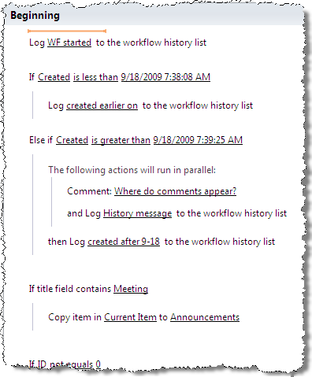
Easily Transfer Workflows between Visio & SharePoint Designer
Each tool plays a specific role
Visio allows business analysts to define processes
SPD allows power users to implement processes
Round Trip Import/Export
*.VWI
Visio Workflow
Interchange
Notes:
Visio diagrams gives us the structure of the process. Easily created workflows in Visio and export as Visio Workflow Interchange (*.VWI) file. What’s missing are the parameters in this workflow. Import this file in SPD and configure the parameters. The workflow can then once again be sent back to Visio for extending it further.
There is no link between the Visio workflow and the imported SPD workflow. Once it’s imported, none of the changes made in SPD will automatically propagate to Visio. You would have to re-import the file in Visio to see the changes.

Slide 22
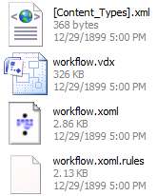
Exporting to SharePoint Designer
Visio exports to a *.VWI file
Renamed zip file containing all workflow files
*.xoml and *.xoml.rules define workflow
*.vdx file contains Visio drawing
Notes:
Both the Visio drawing and *.XOML are stored. This allows SPD to change the workflow and still allow the Visio file to store information outside of the raw workflow shapes, for example annotations.

Slide 23
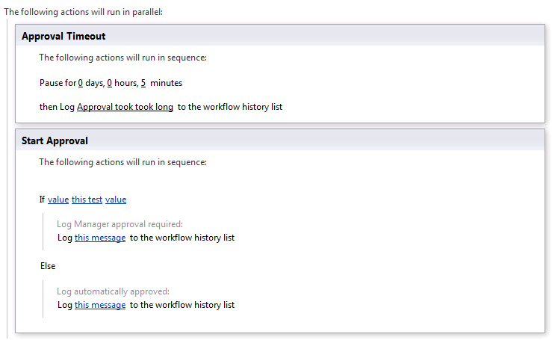
Enhancing the Imported Process
Often changes need to be made to process
New sequential or parallel steps can be added
New conditions or actions can be added
If else blocks are available
Notes:
What happens if we miss something in Visio? We can add new actions and steps as needed in the designer as well.

Slide 24
DEMO
Visio Workflow Integration

Slide 25
Agenda
What is Workflow?
Types of SharePoint Designer Workflows
Tools to Create Workflows in SharePoint
Visio Integration with Workflows
InfoPath Integration with Workflows
Task Process Designer
Packaging of Reusable Workflows

Slide 26
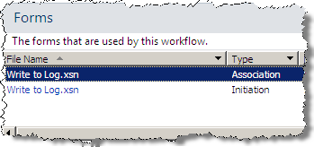
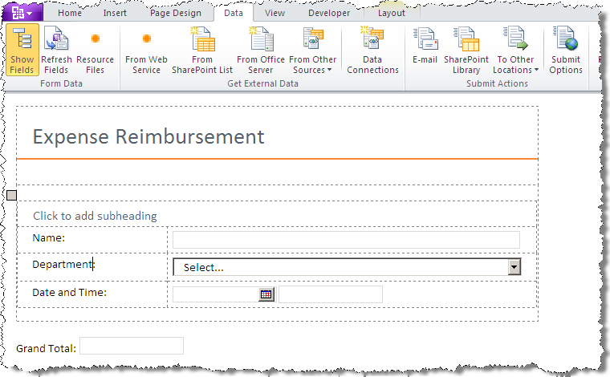
Edit InfoPath Forms Generated by SharePoint Designer Workflows
Notes:
Workflows created in SharePoint Designer automatically create one or more forms, as called for by the workflow logic, that facilitate the interaction with the end user. These forms are created with a *.XSN extension which is actually an InfoPath form template. You can click on any of these forms and InfoPath will open up to let you customize this form.
InfoPath is an extremely powerful electronic form generation tool that will let you work with a vast collection of user input controls, perform data validation and conditional formatting, configure a variety of rules which would execute based upon the conditions you setup and a whole lot more. All of the InfoPath functionality is available at your disposal when modifying the workflow forms.

Slide 27
DEMO
InfoPath Integration

Slide 28
Agenda
What is Workflow?
Types of SharePoint Designer Workflows
Tools to Create Workflows in SharePoint
Visio Integration with Workflows
InfoPath Integration with Workflows
Task Process Designer
Packaging of Reusable Workflows

Slide 29
Departmental Document Approval
Tasks are part of a larger approval process
Hierarchical assignments
Automatic data binding for common lookups

Slide 30
Example: Expense Reports
Report filled out and uploaded to server
Send to manager(s) for their approval
If successful, reimburse the expenses

Slide 31
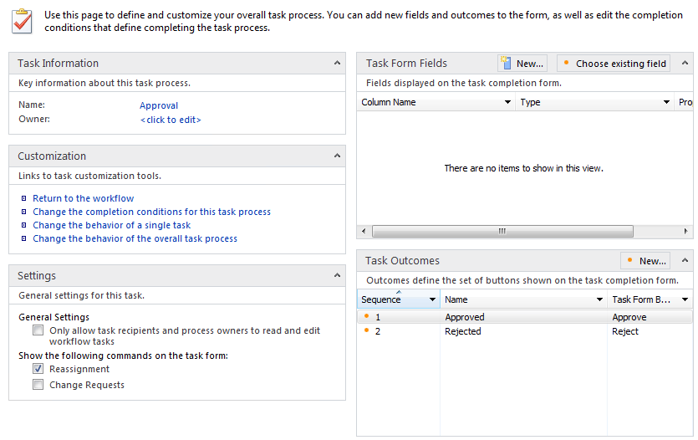
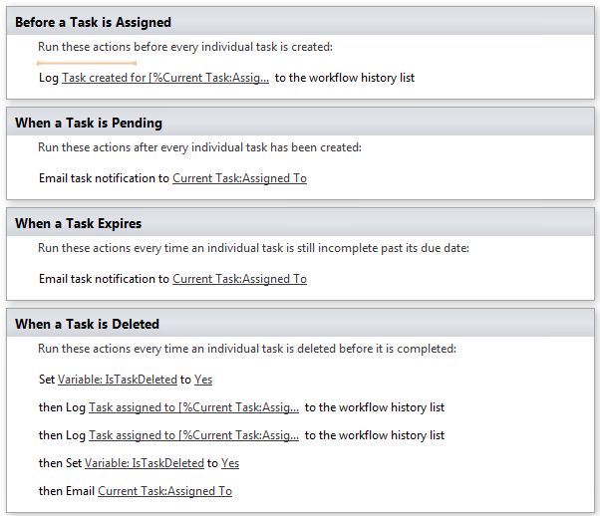
Task Process Designer: Foundation of the Out-of-Box Workflows
Task processes
Allows specialized conditions for completion
Allows actions to be performed on key events
Started, Pending, Cancelled, Completed
Notes:
Real life approvals are complex. They may involve requesting changes or reassigning tasks. SPD 2010 has full approval processes available.
The Task Process Designer is a workflow designer within a workflow designer. It allows you design a single workflow task type that you can assign to users and groups, who will execute these tasks sequentially or parallel to each-other.
You can create more than one of these blocks of users:
Assign to Group A, Group B, User A. Execute in parallel.
Assign to User B, User C. Execute sequential (B first, then C).
Assign to Group C, User D. Execute in parallel.
At each step within a task instance (creation, change etc..) you can model specific steps to be performed. You can declare at what point in time the mini-workflow completes. You can declare what happens when it completes.
The general idea here is that this task designer gives a small state-machine like workflow within the sequential steps of the real workflow.

Slide 32
DEMO
Task Process Designer

Slide 33
Agenda
What is Workflow?
Types of SharePoint Designer Workflows
Tools to Create Workflows in SharePoint
Visio Integration with Workflows
InfoPath Integration with Workflows
Task Process Designer
Packaging of Reusable Workflows

Slide 34
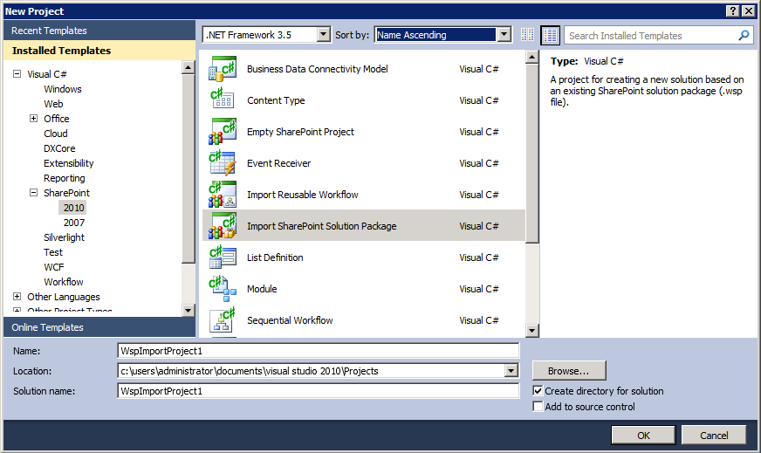
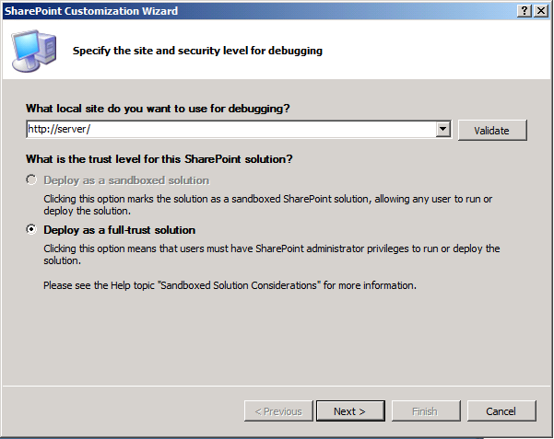
Package Workflows as Solutions (WSPs) to Extend Further in Visual Studio
Notes:
Reusable workflows can be ‘Saved as Template’ which packages them in a *.WSP file [package] and automatically places them in the Site Assets library for the site. The package can then be imported in Visual Studio.
The import process converts WSP and:
Allows extension of existing SPD workflows.
Moves workflow into source controlled project.
Allows inclusion of workflow into full application.

Slide 35
Custom Workflows in SP2010
SharePoint Designer or Visual Studio 2010
SPD targeted to Power Users
Visual Studio targeted to Developers
Integration allows users to work together
SharePoint Designer
2010
Visual Studio 2010
Notes:
Each tool plays to its strength:
SPD provides quick solutions that are buildable by power users. This can be a business analyst or a manager that needs a quick solution.
Visual Studio provides a robust development environment that requires more specialization to use, but also provides more power.

Slide 36


Bringing SPD and Visual Studio Together
Both tools can be used together
SPD Workflows can be imported into VS
VS can create custom SPD Actions
Allows for two way collaboration
Workflows
Custom Actions
Power User using SPD 2010
Developer using VS2010
Notes:
Export/Import Workflow Scenario:
A manager creates a simple workflow to manage approval of press releases. This workflow allows them to be notified when a new press release is submitted and manage the approval process. It is so successful that other departments want to use it. The IT department is asked to take this prototype workflow and add some reporting functionality and an integration point with a LOB system that manages all press releases. A developer in the IT department exports the existing workflow from SharePoint and imports it into Visual Studio 2010. They modify the workflow as appropriate using the capabilities of Visual Studio and publish it as a SharePoint solution. The solution is deployed to the entire farm and all departments can now use the approval workflow.
Custom Actions Scenario:
The IT department is asked to help several departments automate their document archiving processes. Each department has slightly different rules, but they all have one task in common; they need to submit information to an existing LOB system. Since SPD fits their needs in all cases except this one interaction, a developer in the IT department creates a custom activity to manage the interaction with the external system and wraps it as a custom SPD action. Using Visual Studios SharePoint solution project, they package their custom action and deploy it to the farm. Each department is now able to build their own custom process in SPD using the custom action developed in Visual Studio.

Slide 37
DEMO
Packaging Workflows as Solutions

Slide 38
Summary
What is Workflow?
Types of SharePoint Designer Workflows
Tools to Create Workflows in SharePoint
Visio Integration with Workflows
InfoPath Integration with Workflows
Task Process Designer
Packaging of Reusable Workflows

